Slide 1
PAINTING
LECTURE 02

Slide 2
What is Painting
Painting is the practice of applying paint, pigment, color or other medium to a surface (support base). The medium is commonly applied to the base with a brush but other objects can be used on different surfaces.
Creating an image in any medium on any surface is called painting.

Slide 3
"Painting only can "describe" everything which can be seen and suggest every emotion which can be felt!
Contemporary artists have extended the boundaries of painting considerably to include; collage, different materials such as sand, cement, straw or wood for their texture.

Slide 4
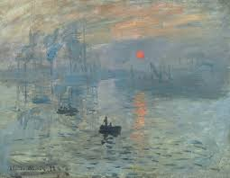
Types (Genre) of Painting
1. Landscape Painting
A landscape is an
outdoor scene. A landscape
artist uses paint to create
not only land, water, and
clouds but air,
wind, and sunlight.
“Sunrise” by French Artist Claude Monet

Slide 5
Landscape by Amber Munir

Slide 6
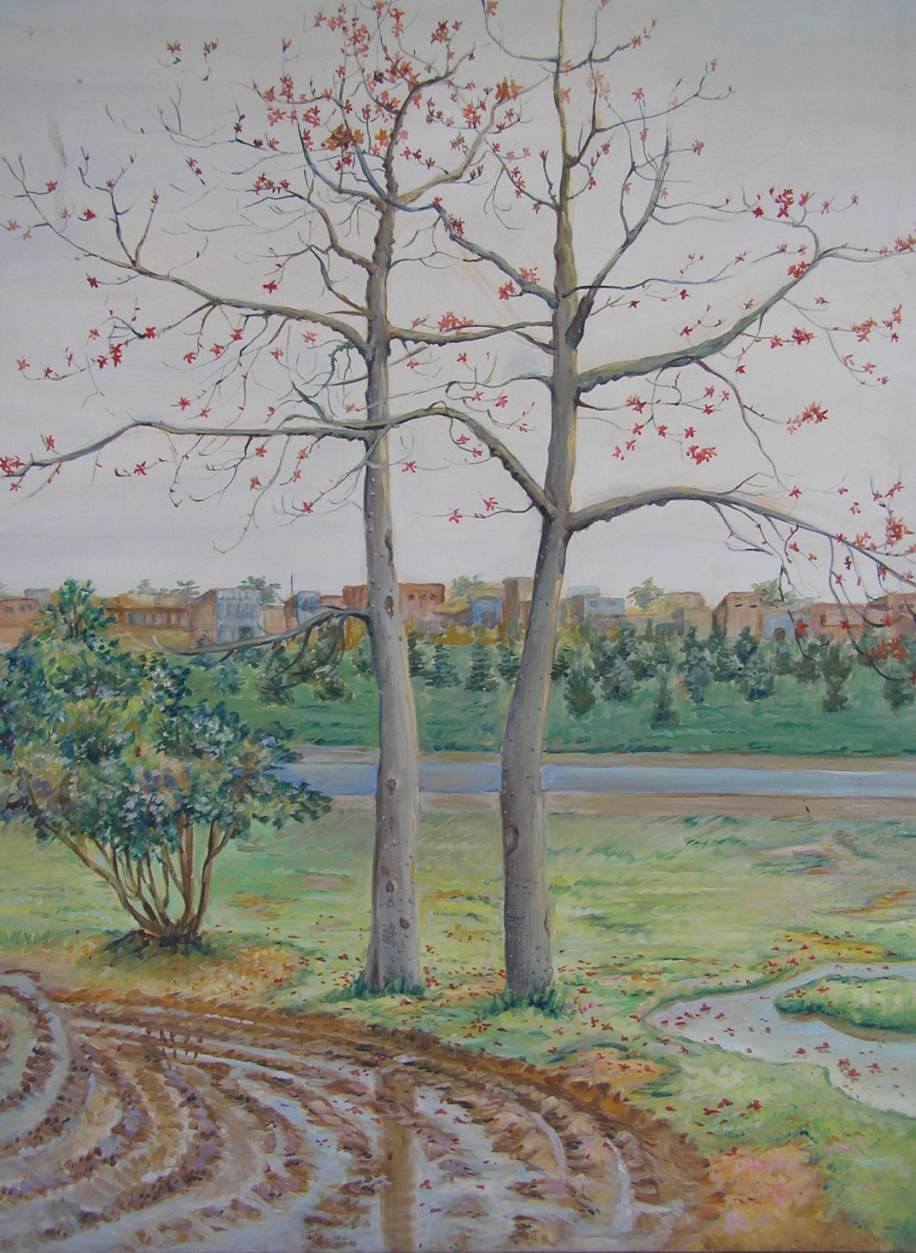

Slide 7
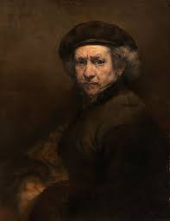
2. Portrait Painting
A portrait is an image
of a person or animal
(from head to shoulders
or torso). Besides
showing what someone
looks like, a portrait often
captures a mood or
personality.
“Self Portrait” by Dutch Great master Rembrandt Van Rijn, 1659

Slide 8
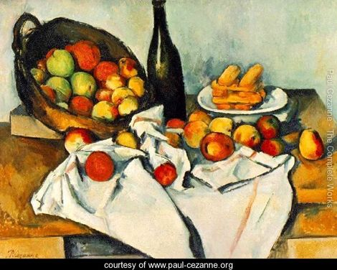
Still life Painting
A still life shows objects,
such as flowers, food, or
musical instruments. A
still life reveals an artist's
skill in painting shapes,
light, and shadow.
“The Basket of Apples” by Paul Cezanne,
1893

Slide 9
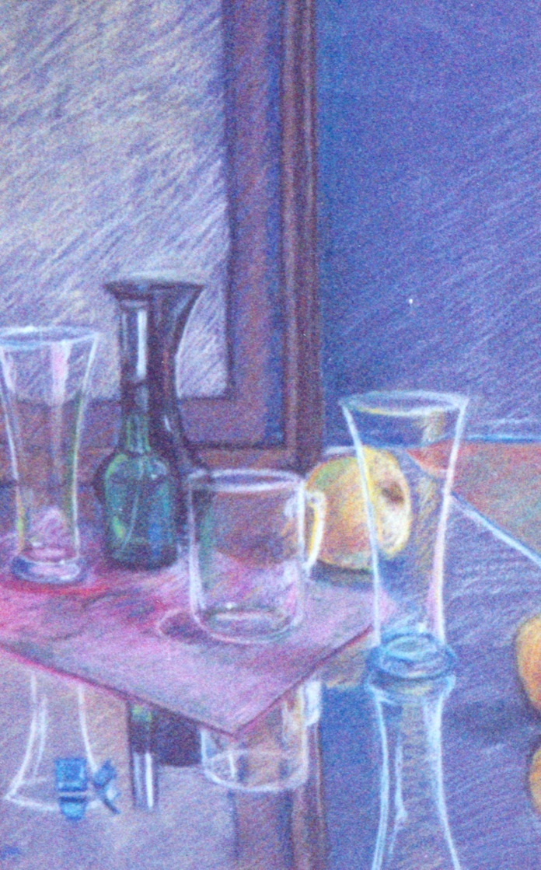

Slide 10
Stillife Painting by Amber Munir

Slide 11
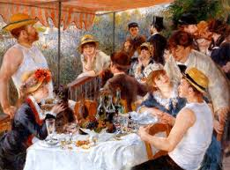
Real Life Paintings
A real life scene captures
life in action. It could show
a busy street, a beach
party, a dinner gathering,
or anyplace where living
goes on.
“Luncheon of the Boating Party”
by Auguste Renoir, 1881

Slide 12
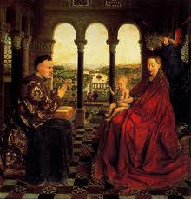
Religious Paintings
A religious work of art
shares a religious message.
It might portray a sacred
story or express
an artist's faith.
“Madona of Chancellor Rolin”
by Jan Van Eyck, 1435

Slide 13
Techniques of Painting
Mural
Easel
Miniature

Slide 14
Sub-Techniques of Mural Painting
Fresco (Boun)
Fresco ( secco)
Mosaics
Stained Glass
Tempera
Mix Media

Slide 15
1. Fresco (Boun)
Meaning "fresh" in Italian, fresco is the process of painting done directly into the wet plaster on walls. In true fresco, pigments (often of tempera) are applied to small working sections of wet plaster. Once dry, the pigments become a permanent part of the wall.

Slide 16
The Arena Chapel (The Flight into Egypt)

Slide 19
2. Fresco (Secco)
The technique of painting in water-based colors on dry plaster. Also called dry fresco or Secco

Slide 20
Egyptian Tomb Painting 13th BC

Slide 21
Painting of Buddha (Ajanta Caves)

Slide 22
A 6th-century mosaic in Ravenna's Basilica di Sant'Apollinare.

Slide 23
Fresco Mural painted by Sadequain

Slide 24
Fresco Mural painted by Sadequain

Slide 25
Fresco Ceiling painted by Sadequain

Slide 26
3. MOSAICS
The design is created by small pieces of colored glass, stone, or ceramic fixed in wet mortar which has been spread over the surface to be decorated. Their slightly irregular placement on a surface creates a very lively, reflective surface when viewed at a distance. This was often used to decorate walls, floors, and ceilings.

Slide 27
At Roman Bath (Sea Horse)

Slide 28
Byzantine Mosaic

Slide 29
Early Christian Mosaic, Istanbul

Slide 30
Christ and the Apostles in the Heavenly Jerusalem, apse mosaic, early fifth century, Rome, Santa Pudenziana.

Slide 31
Old Mosaic (Early Christian Art)

Slide 33
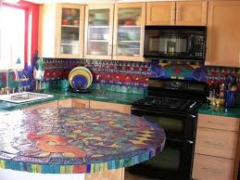
Modern Mosaics

Slide 34
4. Stained Glass
Colored glass used to make decorative windows and other objects through which light passes. Stained glass is often made in large, richly detailed panels that are set together in a framework of lead. Like all colored glass, it acquires its color by the addition of metallic oxides to molten glass.
A purely Western phenomenon, stained glass originated as a fine art of the Christian church, beginning in the 12th–13th century, when it was combined with Gothic Architecture to create brilliant, moving effects.

Slide 41
Interior of the Church ( Stained Glass windows)

Slide 43
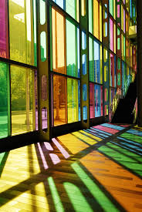
Modern Stainglass

Slide 44
5. Tempera
Tempera paint is made by adding pigments ground to a fine powder and mixed with egg yolk to a uniform color. Tempera paint is bold, it is easy to use on any surface and is nearly permanent once dry.

Slide 46
By Sandro Botticelli

Slide 47
Doni Madonna by Michelangelo

Slide 48
Madonna Enthroned by Giotto

Slide 49
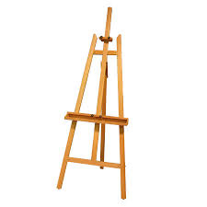
Sub-Techniques of Easel painting
Oil
Acrylic
Water Colors
Gouache
Egg Tempera
Ink
Enamel
Pastels
Crayons
Encaustic Wax
Collage
Mix Media

Slide 50
Oil paints
Powdered colors are mixed with a fine oil, usually linseed oil. A turpentine, is also used to thin the colors as desired, so that the paint can be applied thickly and opaquely, or thinly and transparently. The oil paint is applied to a prepared ground ( wood, stones), usually a stretched canvas with a coating of neutral pigment.

Slide 51
Painted by Dr. Khalid Mahmud

Slide 52
Painted by Ali Azmat

Slide 53
Painted by Saeed Akhtar (Self Portrait)

Slide 54
Painted by Sumera jawad

Slide 55
Painted by Rabia Yaseen

Slide 56
Acrylic
Acrylics are artificial compounds developed in the twentieth century.
The binder used includes water, and the paints can be thinned with water, but once the paints dry, they have a glossy, permanent surface that resembles the surface created by oils.
These paints can create most of the effects accomplished in oils, and have the advantage of not requiring the use of turpentine, which is toxic.
The major disadvantage of acrylics is that it will dry much more quickly. Since many artists prefer to be able to re-work the colors, many prefer oils to acrylics. However, many modern artists do choose acrylics.

Slide 57
Painted by R. M. Naeem

Slide 59
Painted by Shireen kamran

Slide 60
Painted by Asim Amjad

Slide 61
Painted By Rabia Yaseen

Slide 62
Painted by Amber Munir

Slide 63
Enamels
Enamel paints are most often like oil paints- , latex (plasticity) or paints with varnish added to them. In use since the 1930s, enamels can be applied to traditional fine-art utensils (pottery), spray
Applied on walls and windows as well.
Mostly used in mix media.

Slide 66
Water Colors
Powdered pigments are mixed with gum-arabic or a similar substance that will help them to stick on to a surface. The artist then mixes them with water and applies them to a ground, usually paper, with a soft brush. The final effect is that of transparent washes of color.
This method was the most important method of painting in China and Japan from an early date, but did not become popular with European artists until after the 16th century.

Slide 67
Painted by Dr. Ejaz Anwar

Slide 68
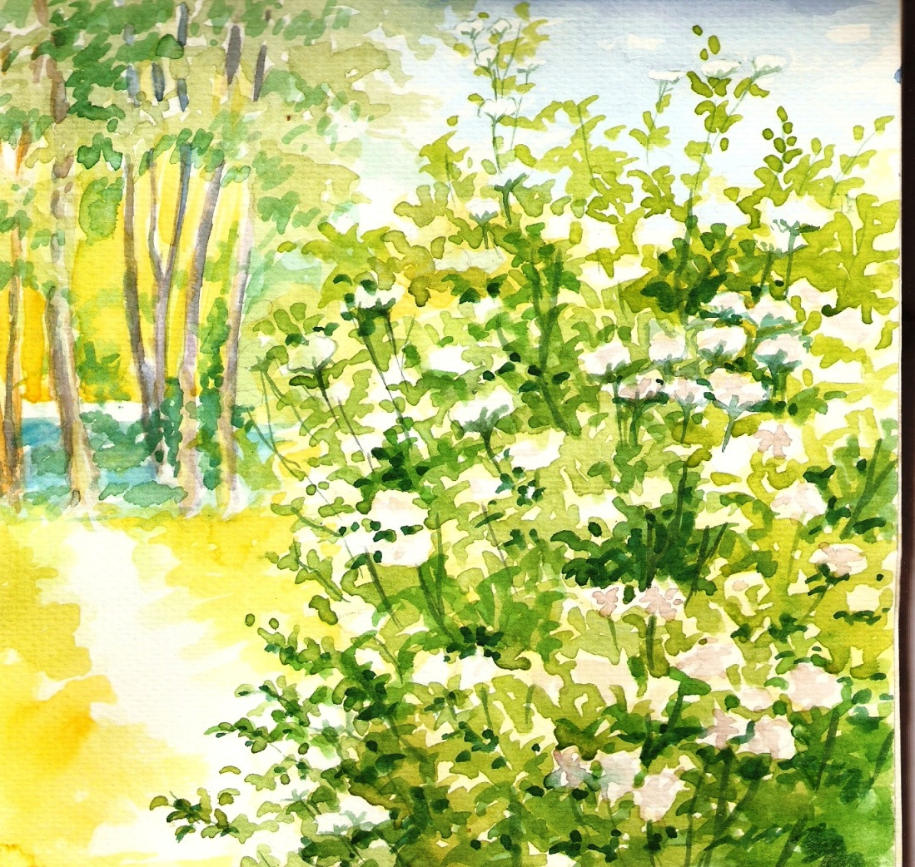

Slide 69
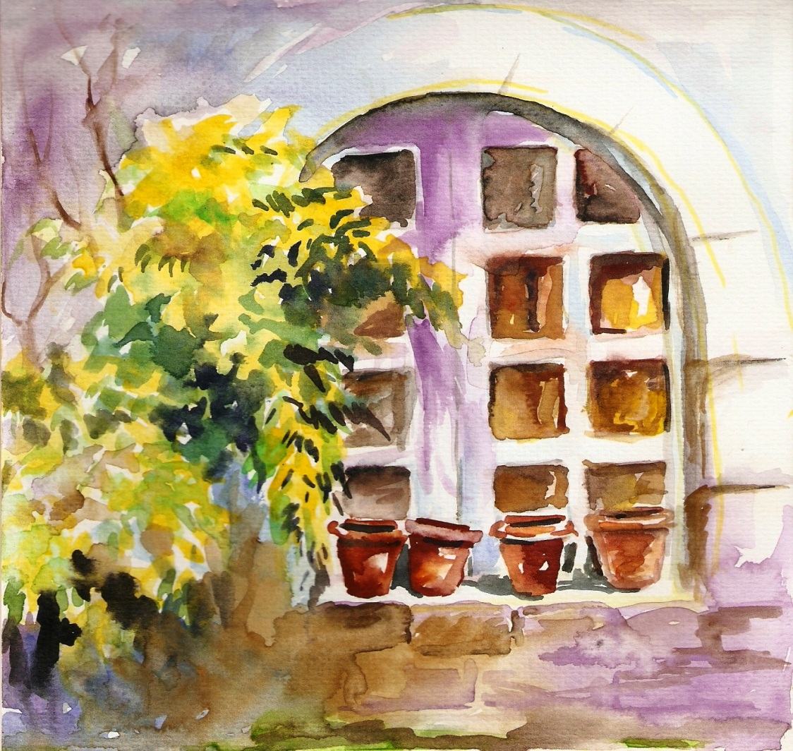

Slide 74
Painted by Amber Munir

Slide 75
EGG TEMPERA
In this method, the pigment is mixed with egg yolk or both the yolk and white of an egg. It is thinned with water and applied to a gesso ground (plaster mixed with a binding) on a panel. This type of painting dries very quickly and produces an opaque, matte surface. The colors tend to dry to a lighter value than they appear when wet. Egg tempera was used for panel painting until the 15th century.

Slide 76
Collage
The word collage comes from the French verb "coller," meaning "to paste." In this technique photographs, news clippings or other objects are pasted on the painting surface and may be combined with painted areas.

Slide 77
Paper Collage

Slide 78
MIX MEDIA
Mix Media means to mix any medium with another and it can be in any medium or surface.
Number of mediums can be used and mixed to produce an art work.

Slide 79
Mix media by Asad Faruki

Slide 80
Mix Media by Asad Faruki

Slide 81
Mix Media by Asad Faruki

Slide 82
Mix Media b Asad Faruki

Slide 83
Mix Media By CY. Towmbly

